Slide 1
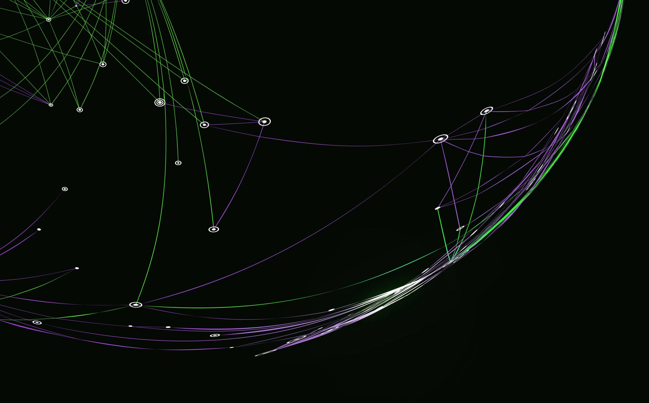
ABALONE AGE PREDICTION
Kavyasri Avushapuram
700728990

Slide 2
MOTIVATION
Abalone age prediction has lot of importance economically. Also, it helps farmers in knowing the right age for poaching. It is very complex thing to do manually which only adds to the pricing. A dataset having physical measurements of abalone and its age is available for the study. Researchers have previously worked on this problem but not many has achieved an acceptable model. This might be attributed to quality and quantity of the data. This leaves for a lot of scope for research.

Slide 3
OBJECTIVE
1.Understand the difficulties in abalone dataset and apply possible feature engineering techniques.
2.Experiment with parameter tuning and model evaluation techniques.
3.Understand and compare various regression and classification models.
4.Experiment with ensemble models the new state of the art.
5.Our end goal is to find a good predictive model that estimates age of abalone with as less as possible.

Slide 4
RELATED WORK
https://www.kaggle.com/code/shubh247/abalone-age-prediction
Used Machine Learning approaches but accuracy less than 60% on test dataset
M. F. Misman et al., "Prediction of Abalone Age Using Regression-Based Neural Network," 2019 1st International Conference on Artificial Intelligence and Data Sciences (AiDAS), 2019, pp. 23-28, doi: 10.1109/AiDAS47888.2019.8970983.
Used Neural Network Deep Learning approaches considering rings prediction as regression problem
E. Sahin, C. J. Saul, E. Ozsarfati and A. Yilmaz, "Abalone Life Phase Classification with Deep Learning," 2018 5th International Conference on Soft Computing & Machine Intelligence (ISCMI), 2018, pp. 163-167, doi: 10.1109/ISCMI.2018.8703232.
Used Neural Network Deep Learning approaches considering rings prediction as classification problem

Slide 5
PROBLEM STATEMENT
Scientifically, the age of abalone is determined by cutting the shell through the cone, staining it, and counting the number of rings through a microscope.
This is such a complex, time consuming task and adds to the increase in abalone price.
Using Machine Learning to estimate the rings(there by age) of abalone using other physical measurements.

Slide 6
DATA
Feature Type | Feature Name | Range
Input | Sex | integer [1, 3]
Input | Length | real [0.075, 0.815]
Input | Diameter | real [0.055, 0.65]
Input | Height | real [0.0, 1.13]
Input | Whole_weight | real [0.0020, 2.8255]
Input | Shucked_weight | real [0.0010, 1.488]
Input | Viscera_weight | real [5.0E-4, 0.76]
Input | Shell_weight | real [0.0015, 1.005]
Output | Rings | integer [1, 29]

Slide 7
CHALLENGES
Highly imbalanced dataset
Skewed Features
High correlation among input features

Slide 8
PROPOSED SOLUTION
To address imbalance in data set use SMOTE oversampling technique to balance the data
To address skewness, data needs to be transformed using functions such as log, sigmoid, cube root. Note these functions did not work well on abalone data.
When two features are highly correlated one of them can be dropped.

Slide 9
MODELS USED
Regression
Linear Regression
Support Vector Regression
Classification
Linear Discriminant Analysis
Random Forest
Ensemble
Adaboost classifier
Gradient boost classifier
Gaussian Process Regression
K nearest neighbors
MLP classifier
Support Vector classifier
Naïve Bayes
Decision Tree
Histogram based gradient boost classifier
Voting classifier
Stacking classifier

Slide 10
RESULTS
Accuracies of various models on unbalanced data.
Accuracies of various models on SMOTE balanced data.
S. No | Model | Test Accuracy %
1 | LDA | 27.6
2 | ANN | 26.03
3 | KNN(3) | 21.6
4 | SVC | 25.5
5 | Naïve Bayes (Complement) | 20.01
6 | Decision Tree | 17.98
7 | Random Forest | 24.5
8 | Linear Regression | 23.06
9 | SVR | 25.6
10 | GPR | 23.1
11 | Adaboost | 22.4
12 | Gradient boost GB | 24.07
13 | Histogram GB | 10.29
14 | Voting(RF,2NN,SVC) | 23.7
15 | Stacking(2NN, RF) | 27.12
S. No | Model | Test Accuracy %
1 | LDA | 23.07
2 | ANN | 26.9
3 | KNN(3) | 62.3
4 | SVC | 27.09
5 | Naïve Bayes (Complement) | 12.4
6 | Decision Tree | 56.7
7 | Random Forest | 67.12
8 | Linear Regression | 12.04
9 | SVR | 19.4
10 | GPR | 22.9
11 | Adaboost | 13.3
12 | Gradient boost GB | 46.6
13 | Histogram GB | 61.61
14 | Voting(RF,2NN,SVC) | 68.79
15 | Stacking(2NN, RF) | 68.39

Slide 11
REFERENCES
M. F. Misman et al., "Prediction of Abalone Age Using Regression-Based Neural Network," 2019 1st International Conference on Artificial Intelligence and Data Sciences (AiDAS), 2019, pp. 23-28, doi: 10.1109/AiDAS47888.2019.8970983.
https://www.kaggle.com/datasets/devzohaib/estimating-the-age-of-abalone-at-a-seafood-farm
https://ubc-mds.github.io/abalone_age_classification/Project_report_milestone2.html
https://archive.ics.uci.edu/ml/datasets/abalone.
Daniel T. Larose, "Multiple Regression and Model Building," in Data Mining Methods and Models , IEEE, 2006, pp.93-154, doi: 10.1002/0471756482.ch3.
https://www.analyticssteps.com/blogs/what-support-vector-regression.
https://www.techopedia.com/definition/32335/naive-bayes
https://www.sciencedirect.com/topics/computer-science/multilayer-perceptron
https://learn.g2.com/k-nearest-neighbor
https://towardsdatascience.com/decision-trees-and-random-forests-df0c3123f991
https://blog.paperspace.com/gradient-boosting-for-classification/

